Slide 1
Momentum 2 Penetration Testing Report
Vulnerable Virtual Machine Analysis
by: Mohamed Ehab Elmasry and badr elwgod
Link to VM: VulnHub

Slide 2
Overview of Momentum 2
A vulnerable VM designed for penetration testing.
Simulates real-world vulnerabilities for practice.
Focus on network configurations, web applications, and privilege escalation.

Slide 3
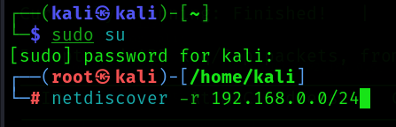
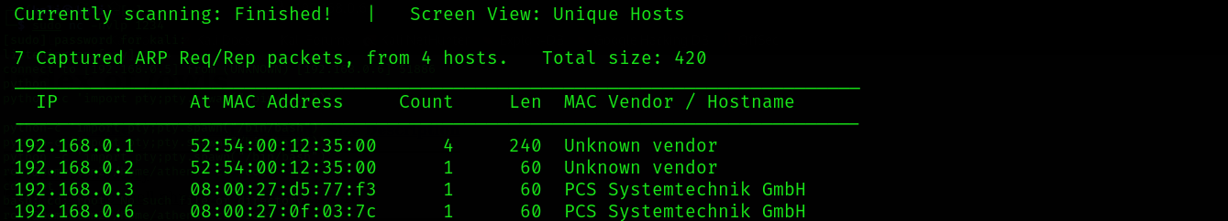
Identify the target

Slide 4

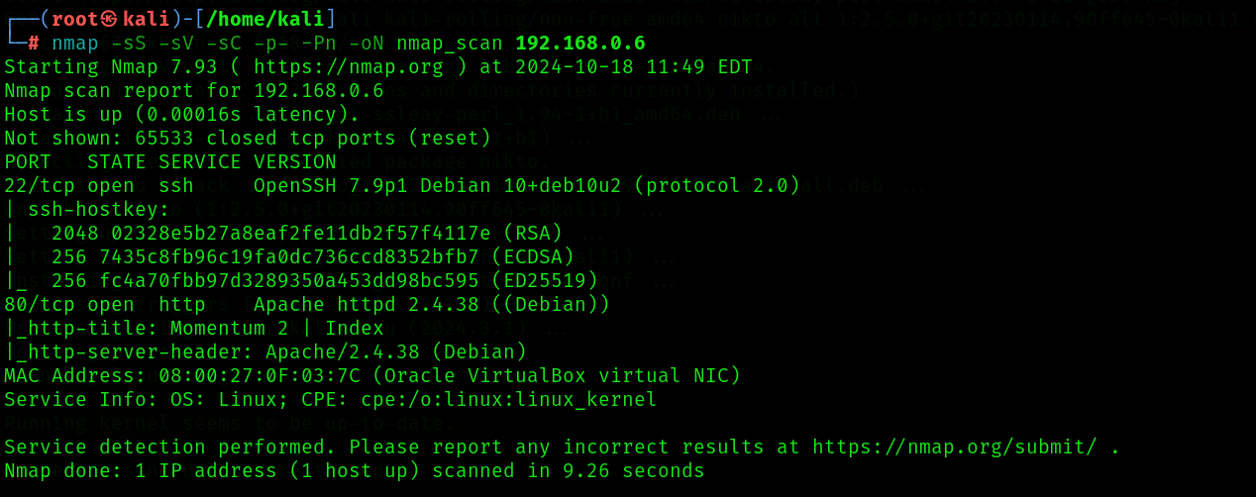

Scan open ports

Slide 5
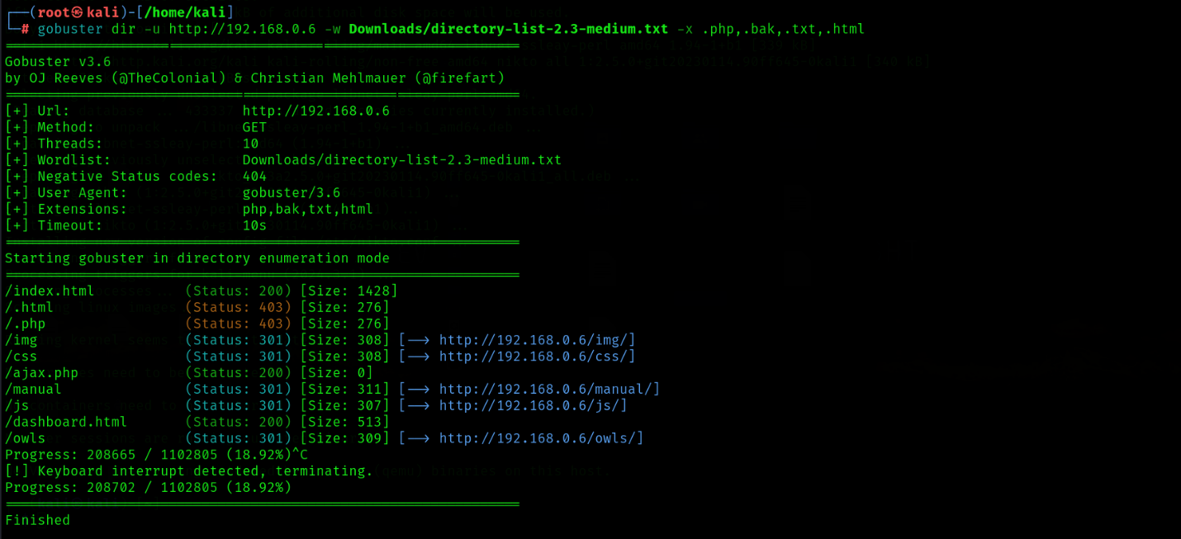
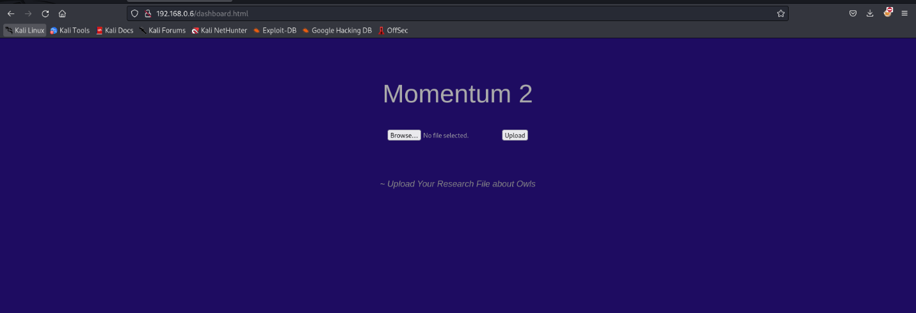
Enumerate web server

Slide 6
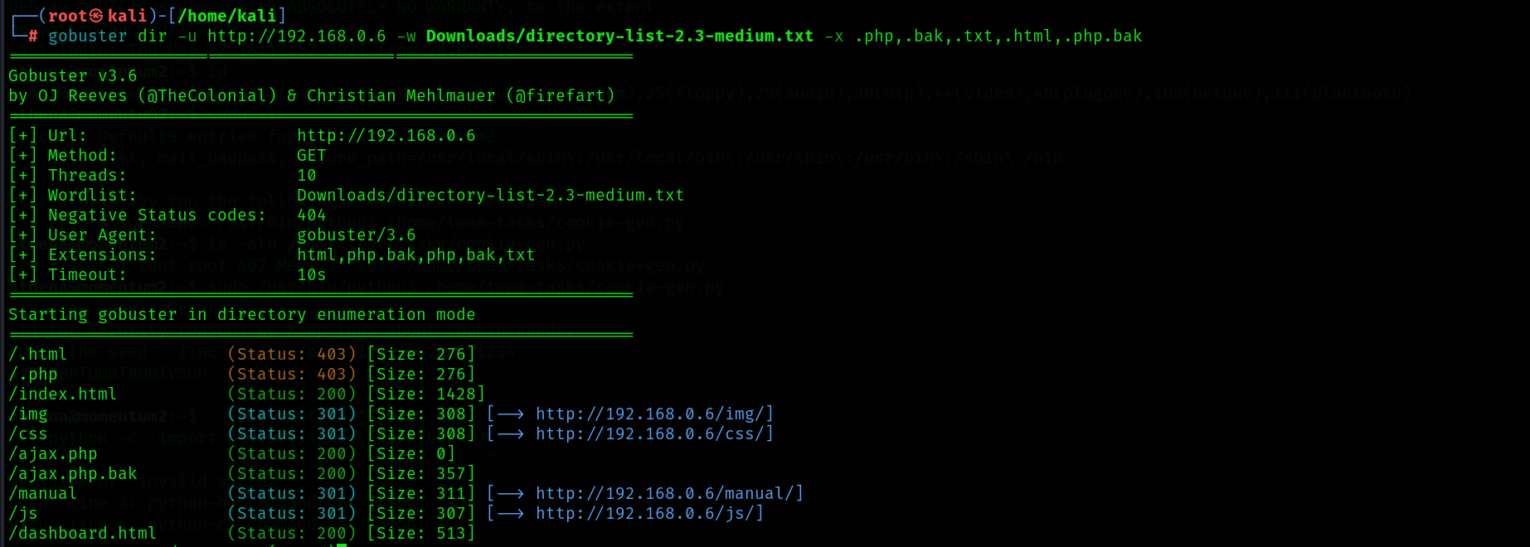
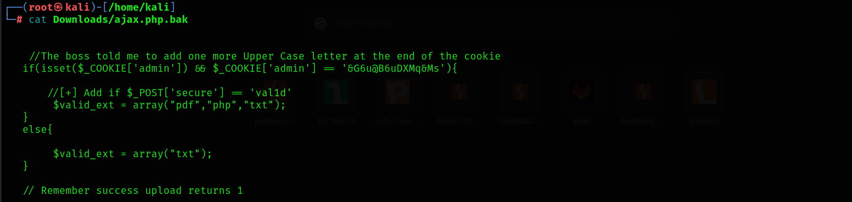

Slide 7
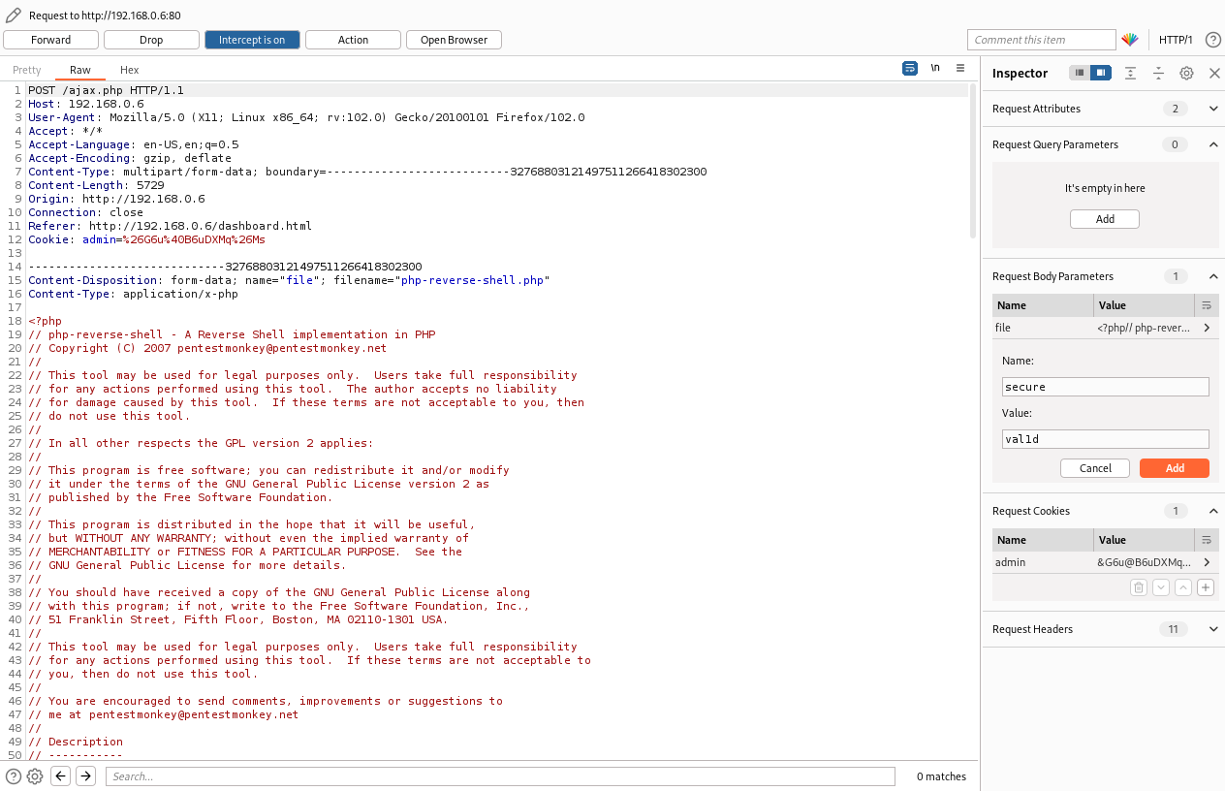
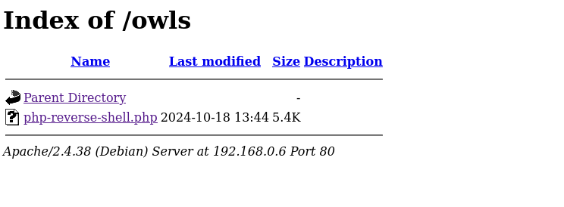
Using burp suite to upload the reverse shell

Slide 8
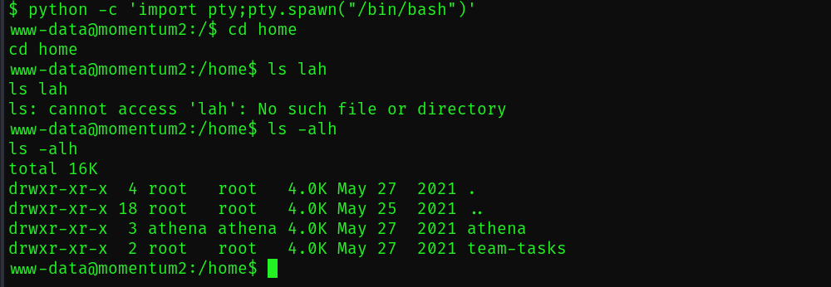
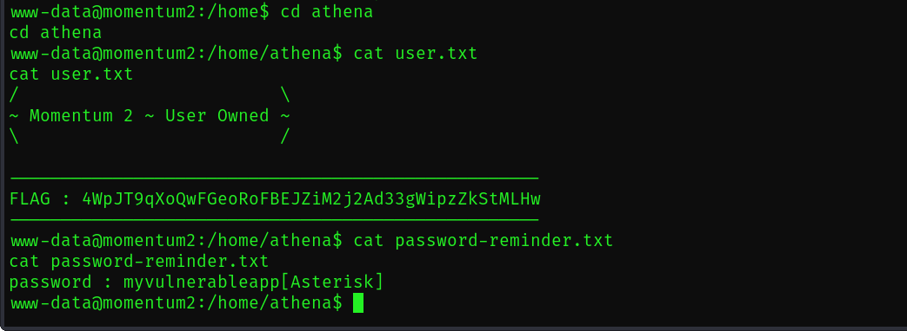
User found after listening by the reverse shell

Slide 9
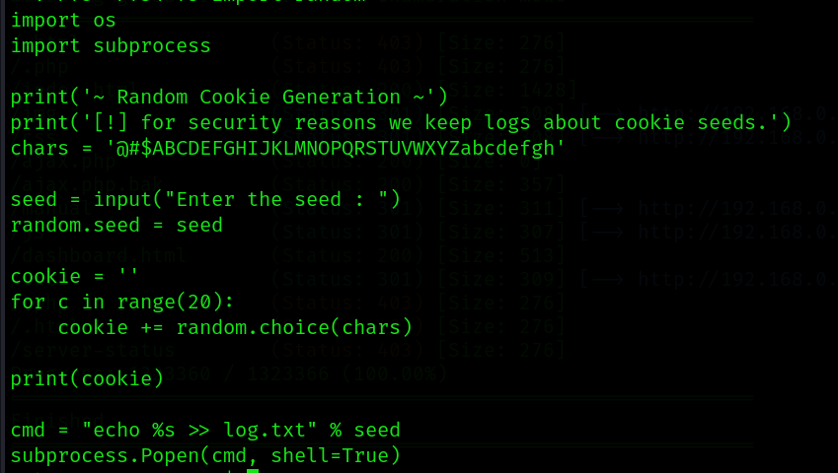
Found a command injection to enter as a root

Slide 10
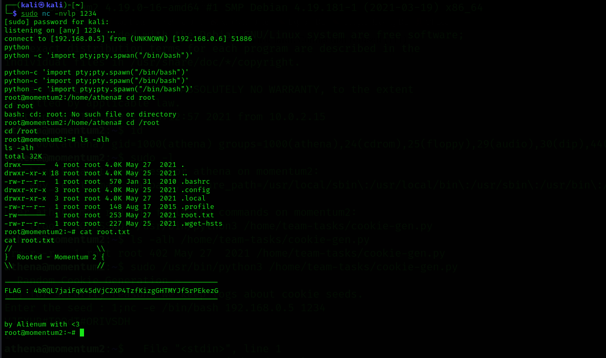
solved

